Slide 1

SMART INDIA HACKATHON 2026
TITLE PAGE
Problem Statement ID – SIH26090
Problem Statement Title – AI-based market linkage for marginalized artisans
Theme – Social Empowerment / Digital Inclusion
PS Category – Software
Team Name – MarketMitra

Slide 2
CHHAAP — VOICE-FIRST MARKET LINKAGE
MarketMitra
PROPOSED SOLUTION
HOW IT ADDRESSES THE PROBLEM
INNOVATION & UNIQUENESS
One photo, one voice note. The artisan photographs the piece and describes it aloud in their own language.
Clean catalogue image. Background removal turns a phone snapshot into a sellable product photo.
Listing written for them. Speech becomes a polished listing, returned in the artisan’s own language.
Fair price, explained. Market comparables set the price; a cost floor protects materials + labour.
One-tap publish. Goes live on ONDC, GeM and WhatsApp with a shareable poster and QR code.
No literacy needed. Every screen speaks. Nothing on the artisan path requires reading or typing.
No English needed. 12 Indian languages, 105 translated strings each, with locale-correct speech.
No photographer needed. The AI does the studio work from an ordinary phone camera.
No middleman needed. The artisan reaches national buyers directly and keeps more of the price.
No guesswork on price. Removes the information gap that lets buyers underpay rural makers.
Voice-first, not voice-added. Built around speech from the first screen, not bolted onto a form.
AI proposes, artisan decides. The craft classifier suggests; the maker confirms. The model never overrides.
Transparent pricing. Comparables and cost floor are shown, so the number is never a black box.
Runs on modest hardware. Full pipeline fits on a single consumer GPU, built for low-resource settings.
Learns from artisans. Every confirmation is a labelled example, improving the model over time.
12
Indian languages
0
words typed by the artisan
1
photo + one voice note
3
channels reached in one tap

Slide 3
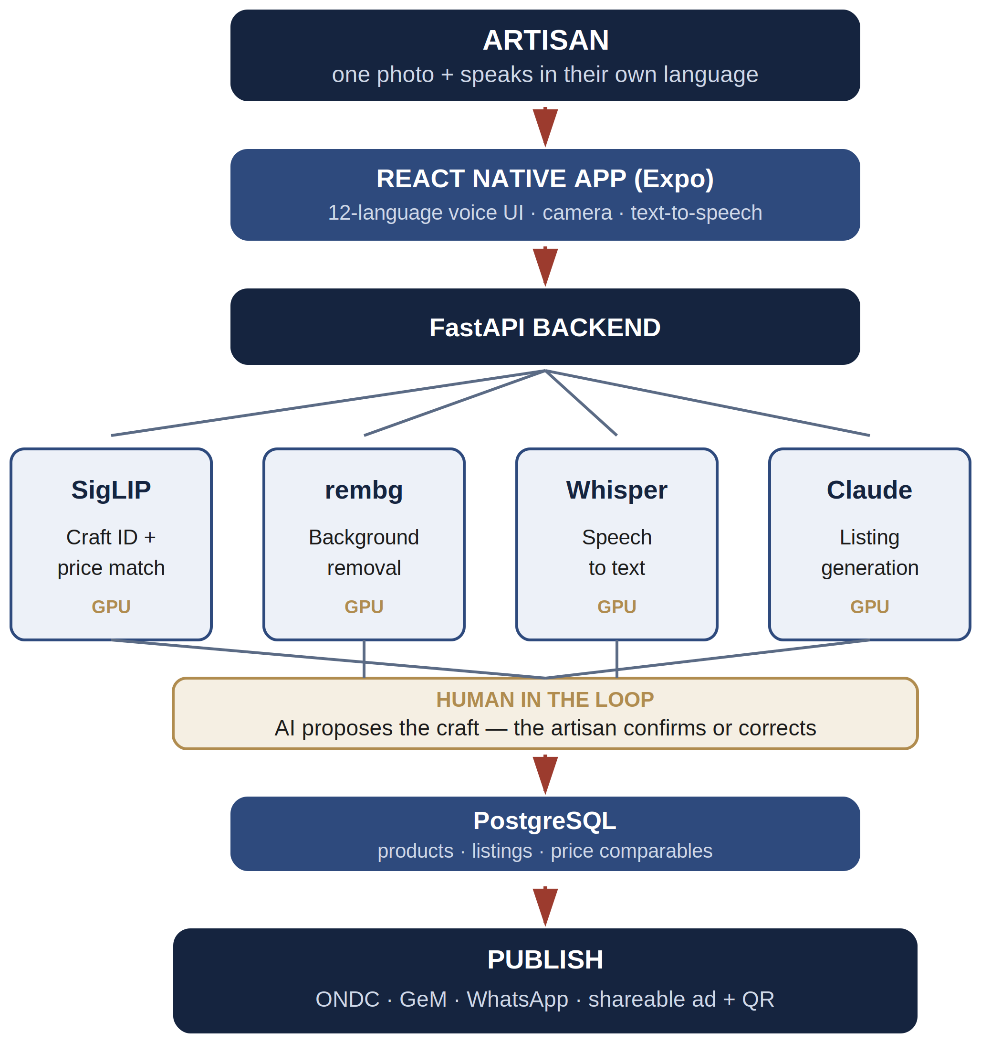
TECHNICAL APPROACH
MarketMitra
ARCHITECTURE
Frontend: React Native (Expo) camera, on-device recording, TTS, 12-language UI.
Backend: Python + FastAPI, containerised with Docker; PostgreSQL for persistence.
Inference: All four models run GPU-accelerated on a single consumer card.
KEY COMPONENTS
SigLIP: embeds the photo to identify the craft and find price comparables.
rembg: removes the background into a clean catalogue image.
Whisper: transcribes the artisan’s spoken description in their language.
Claude: turns the transcript into a listing in that same language.
Pricing engine: similarity match plus a transparent materials + labour floor.
TECHNOLOGY STACK
React Native · Expo · Python · FastAPI · Docker · PostgreSQL
SigLIP · rembg (ONNX) · Whisper · Claude · CUDA

Slide 4
FEASIBILITY AND VIABILITY
MarketMitra
FEASIBILITY OF THE IDEA
Already working. A prototype runs the full loop today : capture, listing, price, publish (end to end).
Proven parts only. Built on established open models and existing India-stack rails (ONDC, GeM); no unproven research required.
Cheap to run. The whole pipeline fits on one consumer GPU, so deployment does not assume cloud budgets.
POTENTIAL CHALLENGES AND RISKS
Uneven language coverage. Speech models are weaker for some Indian languages, Odia among them.
Imperfect craft recognition. A vision model will sometimes read a craft wrongly.
Patchy connectivity and trust. Rural networks drop, and artisans must trust a price they did not set.
STRATEGIES TO OVERCOME THEM
Bhashini for language gaps. Route weak languages through the national mission; interface and prompts are already localised.
Human authority by design. The confirmation screen makes the artisan the final word on their own craft.
Graceful degradation + open pricing. Fallbacks at every step, offline capture on the roadmap, and comparables shown so the price is explainable.
STATUS: working prototype : photo, voice, listing, price and publish already run end to end on one machine.

Slide 5
IMPACT AND BENEFITS
MarketMitra
IMPACT
Income stays with the maker
Direct access to national buyers removes the middleman’s cut.
Dignity and independence
No dependence on a literate intermediary to sell your own work.
Digital inclusion that is real
Works by voice, in the artisan’s language, on an ordinary phone.
Crafts stay alive
Traditional forms remain visible and commercially viable.
USER STORY
Scenario
A weaver in rural Odisha has never sold online. She cannot read English and has no one to write listings for her. Buyers in the city have never seen her work.
With Chhaap
She speaks. One photo and a spoken description in her own language.
She is understood. The craft is recognised; she confirms it herself.
She is paid fairly. A market-aware price with a floor beneath her materials and hours.
She reaches the country. Live on ONDC, GeM and WhatsApp in a single tap.
7M+
artisans in India’s craft economy
12
languages supported today
100%
of the flow usable without reading

Slide 6
RESEARCH AND REFERENCES
MarketMitra
NATIONAL DIGITAL RAILS
ONDC — ondc.org (open network for digital commerce)
GeM — gem.gov.in (government e-marketplace)
Bhashini — bhashini.gov.in (national language translation mission)
MoSJE schemes — socialjustice.gov.in (artisan welfare context)
MODELS AND METHODS
SigLIP — Zhai et al., 2023 (sigmoid loss for language-image pre-training)
Whisper — Radford et al., 2022 (robust multilingual speech recognition)
rembg / U²-Net — Qin et al., 2020 (salient object detection)
Claude — Anthropic (listing generation from transcript)
PROTOTYPE REPOSITORY
github.com/akshayvr-programmer/SIH-SUBMISSION-Chhaap-App
Working code for the app, backend and ML pipeline — open for review.

